Slide 1
USB 6501
Submitted BY
Mohana Priya G
Akshitha K V

Slide 2
What is USB 6501?
The NI USB-6501 is a portable digital I/O device that provides reliable data acquisition and control at a low price.
The USB-6501 is a full-speed USB device that provides 24 DIO lines and a 32-bit counter.
The 24 digital lines are arranged in three ports: P0.<0..7>, P1.<0..7>, and P2.<0..7>. All IO lines can be configured as either input or output individually.
Additionally, P2.7 can be used as a counter triggered by high-to-low transitions.
The default configuration of the USB-6501 DIO ports is open-drain for 5 V operation with an onboard 4.7 kΩ pull-up resistor.
The USB-6501 supplies a nominal 5V from two pins, one on each screw-terminal block.

Slide 3
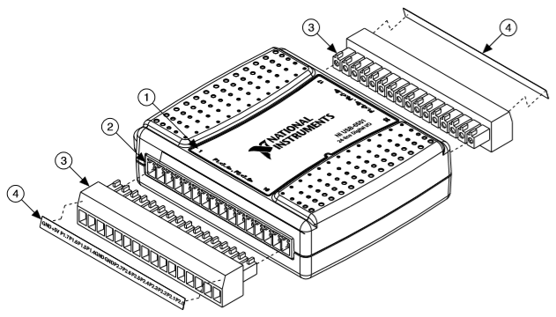
USB 6501
1. Overlay Label with Pin Orientation Guides 2. Combicon Jack
3. Screw Terminal Connector Plugs 4. Signal Name Labels

Slide 4
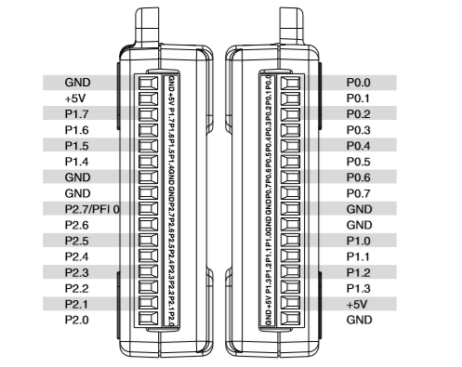
USB 6501 Pin Diagram

Slide 5
USB 6501 Pin Description
Signal Name | Direction | Description
P0.<0..7>, P1.<0..7>, P2.<0..6> | Input or Output Digital | Digital I/O Signals: You can individually configure each signal as an input or output.
P2.7/PFI 0 | Input or Output | This pin is configurable as either a digital line or an event counter. Digital I/O Signal: As a digital line, this signal can be used as an input or output. CTR: As a counter, this signal can be used as an event counter input source.
+5 V | Output | The voltage source provided by the USB host. The voltage is nominally 5 V, but varies from system to system.
GND | — | Ground: The reference for the digital signals and the +5 VDC supply.

Slide 6

DAQ Assistant
The DAQ Assistant is a graphical interface for configuring measurement tasks, channels, and scales.
THE DAQ assistant will recognize the DAQ hardware connected to your computer and will known its capabilities and connection terminals.
It will enable you to define the “task” you want the DAQ to do (read analog channels, set Digital I/O, count pulses, etc..).
It will enable you to select the connection terminals you want to use (port/bit, channel).

Slide 7
Measurement & Automation Explorer(MAX)
NI's Measurement & Automation Explorer (NI MAX) provides access to your National Instruments CAN, DAQ, FieldPoint, GPIB, IMAQ, IVI, Modular Instruments, Motion, NI Switch Executive, VI Logger, VISA, and VXI devices.
MAX will ALSO will recognize the DAQ hardware connected to your computer and will known its capabilities and connection terminals.
You can Create and edit channels, tasks, interfaces, scales, and virtual instruments within MAX.
MAX will enable you to directly read/write to connected devices with a “Test Panels”.

Slide 8
Implementing USB 6501 in LabVIEW STEPS
Launch the DAQ Assistant
Open LabVIEW and create New VI.
Right click on block diagram and select Express -> Input -> DAQ Assist.
2. Create the Task
In this example, we will configure a simple Digital output .
Select Generate signals and then select digital output.
Select the physical channel(Port 0.0) for which you are creating this task.
3. Generate LabVIEW Code
Right click on block diagram and select Vertical Toggle switch and Round LED.
Connect Vertical Toggle switch, Round LED and DAQ Assist .

Slide 9
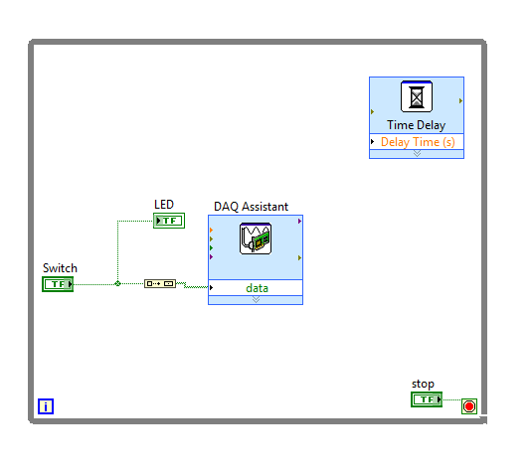
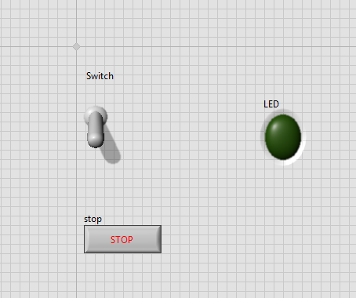
Implementing USB 6501 in LabVIEW
Block Diagram
Front Panel

Slide 10
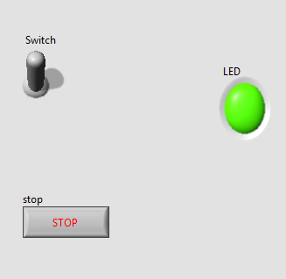
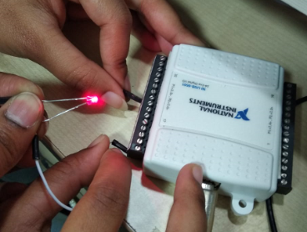
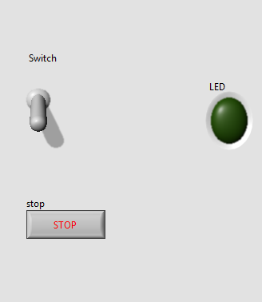
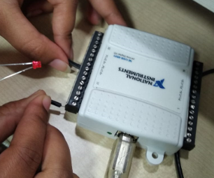
Implementing USB 6501 in LabVIEW 4. Run VI.

Slide 11
THANK YOU

